Slide 1

ATLIQ HOSPITALITY ANALYSIS CODEBASICS CHALLENGE
Designed and Presented By
SHREE SWEDHAA K

Slide 2
AGENDA
1. Introduction
2.Dataset details
3. Dashboard Overview
4. Key Insights
5. Recommendations
6.Outcome from this Analysis
7. Conclusion

Slide 3

Introduction
AtliQ Grands owns multiple five-star hotels across India. They have been in the hospitality industry for the past 20 years. Due to strategic moves from the other competitors and ineffective decision-making in management, AtliQ Grands are losing its market share and revenue in the luxury/business hotels category . As a strategic move, the managing direction of AtliQ Grands wanted to incoporate ”Business &Data Intelligence” to regain their market share and revenue. However, they do not have an in-house data analytics team to provide them with these insights.
Their revenue management team had decided to hire a 3rd party service provider to provide them with insights from their historical data

Slide 4
Dataset Details
We are provided with 3 months booking details data of all the atliq hotels.
Dataset contains 5 excel files.
  Dim_date
  Dim_hotels
  Dim_rooms
  Fact_aggregated_bookings
  Fact_bookings
Metric list excel file
Mock-up Dashboard

Slide 5
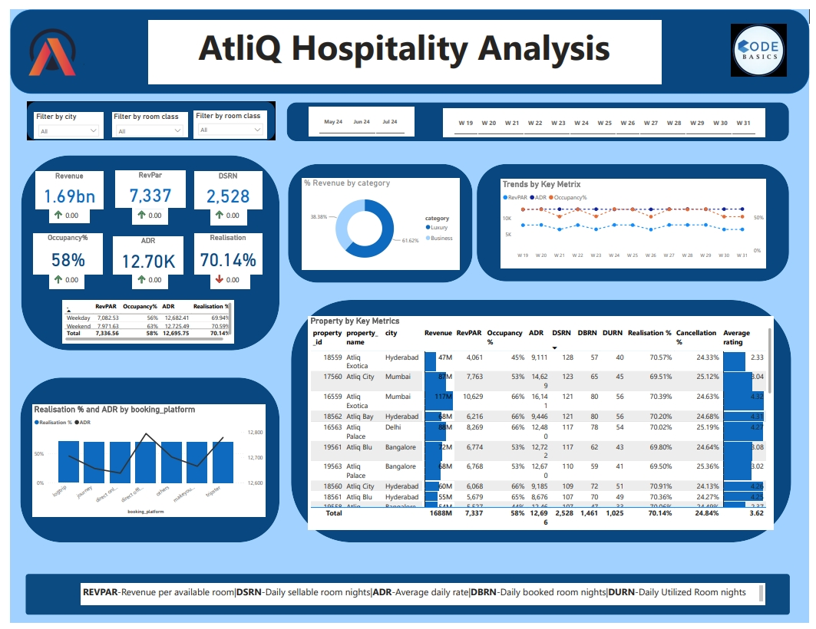
Dashboard Overview

Slide 6
Explanation of Key Metrics:
  Revenue: Total revenue generated.
  RevPAR (Revenue per Available Room): Indicator of revenue management.
  DSRN (Daily Sellable Room Nights): Available room nights.
  Occupancy: Percentage of rooms occupied.
  ADR (Average Daily Rate): Average revenue earned per occupied room.
  Realisation: Percentage of revenue realized against potential.

Slide 7

Key Insights
2.Property Performance:
Top-performing properties: Atliq Exotica, Mumbai with revenue of 210 Million, average rating of 4.32,occupancy rate at 66%,cancellation rate at 24.36%
Low-performing properties: AtliQ Blu, Bangalore with revenue of 72.12 Million, average rating of 3.62,occupancy rate at 57.20%,cancellation rate at 24.49%
1.Revenue Distribution:
Luxury segment: 38.38%
Business segment: 61.62%
Mumbai generates the highest revenue of 669 Million
Highest revenue generated in May of 581.93 Million compared to June and July
5.Occupancy and RevPAR And ADR Trends:
Highest occupany rate in Delhi of 66% and lowest in Bangalore of 55.7%
Weekend occupancy peaked at 62.64%, surpassing weekday rates by 7%
RevPAR and ADR trends: Weekly fluctuations. No major difference.
4.Cancellation Rates:
High cancellation rates in some properties like Atliq Blu,Atliq Grands and Elite-type rooms
Atliq lost around 298 Million in cancellation.
3.Booking Platform Analysis:
Majority of bookings is from other sources followed by make my trip

Slide 8
Recommendations
Enhance Revenue from Luxury Segment:
Promote luxury services and experiences.
Create exclusive offers for high-spending customers.
Invest in luxury amenities and services.
Focus on High-Performing Properties:
Study strategies from high-performing properties.
Implement best practices across all properties.
Regularly review and adjust strategies based on performance data.
Increase Occupancy:
Implement dynamic pricing strategies.
Offer packages/discounts during off- peak seasons.
Enhance online presence and booking ease.
  Reduce Cancellations:
Engage with customers to understand reasons for cancellations.
Introduce incentives for non-refundable bookings.
Enhance the overall customer booking experience.
Optimize Booking Platforms:
Invest in marketing on high-ADR platforms.
Negotiate better terms with underperforming platforms.
Improve user experience on booking platforms.

Slide 9
Outcome from this analysis
Regain their market share in the luxury/business hotels category.
Understanding the revenue trend by week
To get insights where business is failing and what can be done to tackle them

Slide 10
Conclusion
Summary:
Revenue & Performance: Highlighted total revenue and key performance metrics.
Category & City Insights: Noted the dominance of the luxury category and top-performing cities.
Impact:
Growth Potential: Emphasized potential for revenue growth and improved occupancy.
Strategic Focus: Reinforced the importance of targeted investments and optimizations.
Next Steps:
Action Plan: Mention the development of a detailed action plan.
Ongoing Monitoring: Highlight the need for continuous monitoring and strategy adjustments.

Slide 11


